Slide 1
ML Training Session-7
XGBoost

Slide 2
XGBoost Algorithm
Works on learning rate
CHESTPAIN | BLOOD SUGAR | Hearrate >150 | Heart Disease | Average Prediction
0 | 1 | 1 | 0 | 0.6
1 | 1 | 1 | 1 | 0.6
0 | 0 | 0 | 0 | 0.6
1 | 0 | 1 | 1 | 0.6
1 | 1 | 1 | 1 | 0.6
Chest Pain
Blood Sugar
Hearrate
1
0
1
0
1
0
Final Equation = Average prediction + λ * ChestPain Tree + λ * Blood Sugar Tree + λ * HeartRate Tree

Slide 3
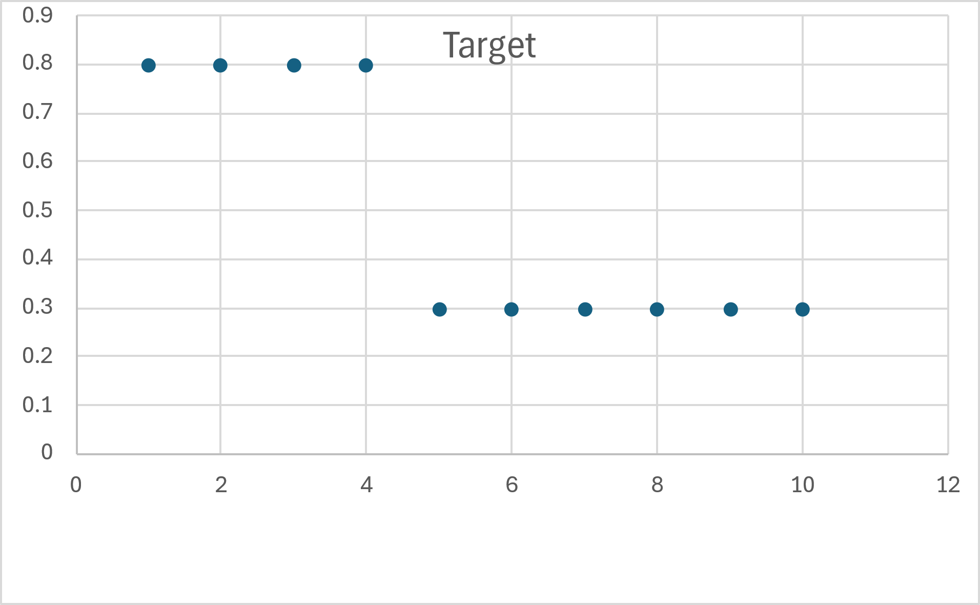
XGBoost Regressor Algorithm Intrepretation
Split happens based on least MSE for regressor
Dtree Regression
Leaf 1
Node is split at value 4, so average for values below 4 go to Leaf1 and average for Values above 4 goes to leaf 2
Leaf 1 o/p → 0.8
Leaf 2 o/p → 0.3
Leaf 2

Slide 4
XGBoost Tree for Classifier and Regressor
Split happens based on Similarity Score or Similarity Weight
Regressor
Sum of residuals squared
λ is parameter for regularization
Similarity Score =
Number of residuals + λ
Classifier
Sum of residuals squared
Similarity Score =
Σ(p *(1-p))+ λ

Slide 5
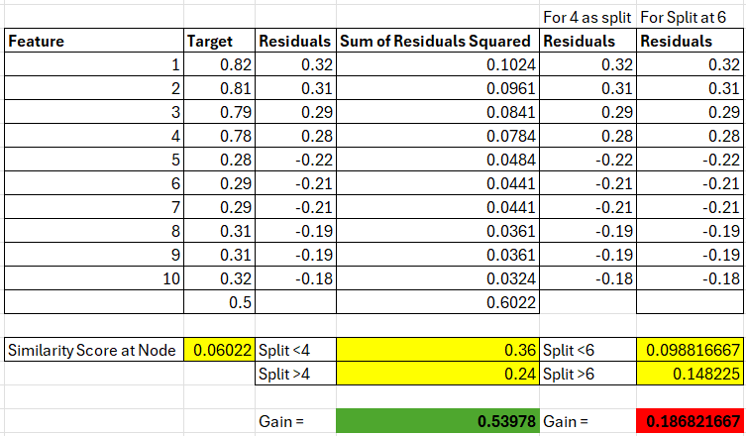
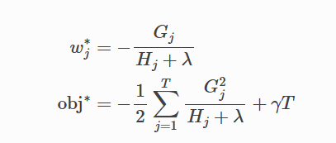
XGBoost Gamma Interpretation
The γ parameter in the model helps in auto pruning the trees such that it reduces the complexity in the tree
Interpretation of Gamma(γ ) :
If Gain – γ >0 , then split happens,
If Gain – γ <0, then split won’t happen

Slide 6

Final Gain Function
Where G here means Gradient of loss function
H is hessiant of loss function
Lambda is regularization parameter
Gamma is the cost complexity pruning parameter

Slide 7
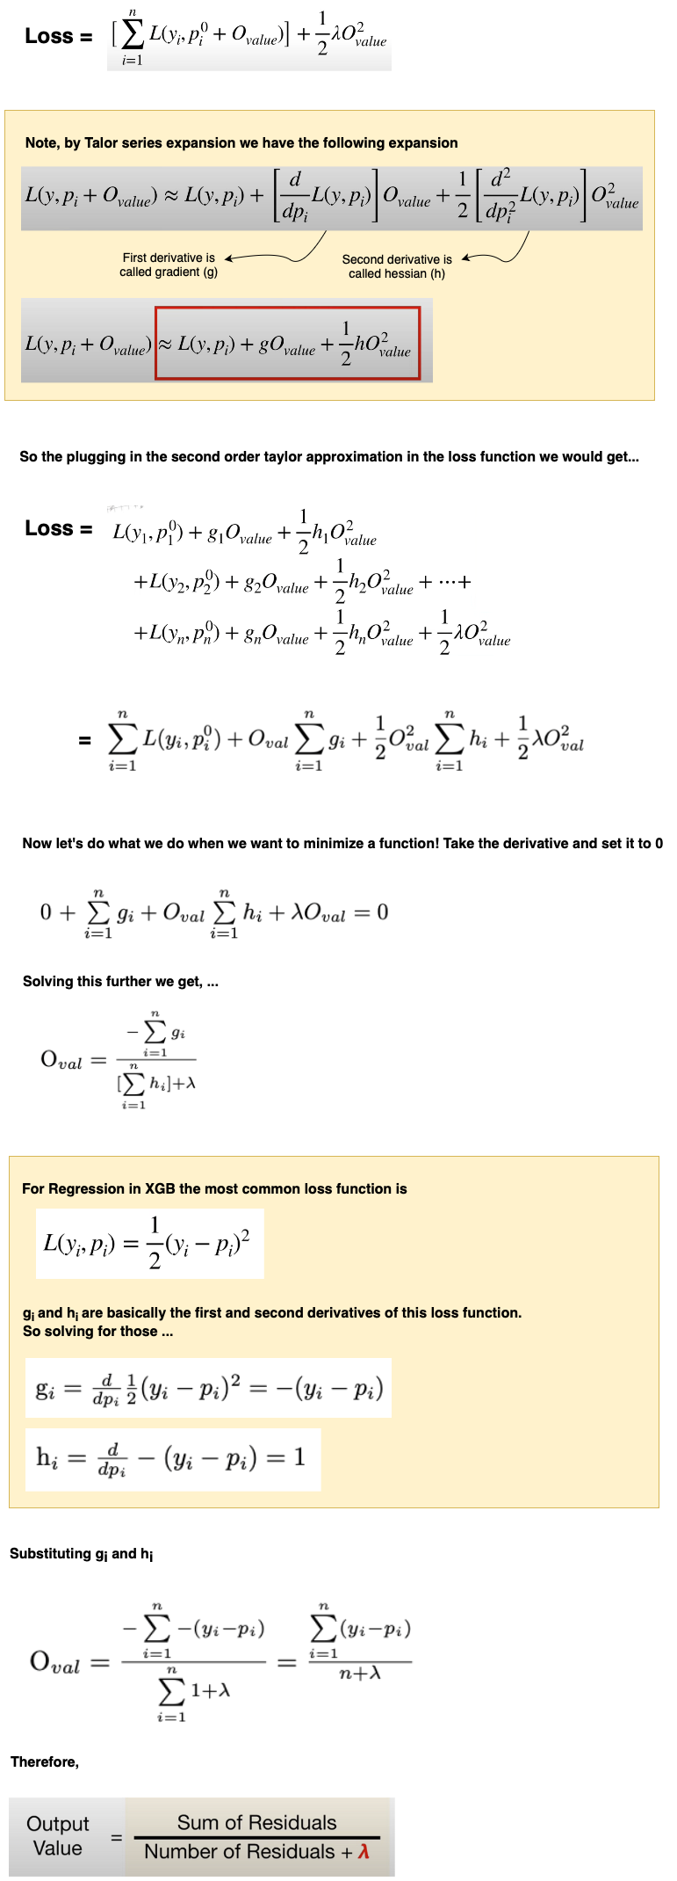
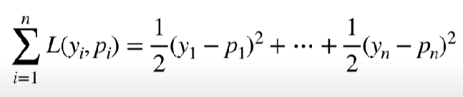

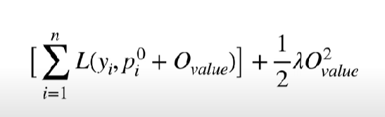
Maths behind XGBoost
Loss function for regressor and classifier
Objective function to be optimized
source

Slide 8
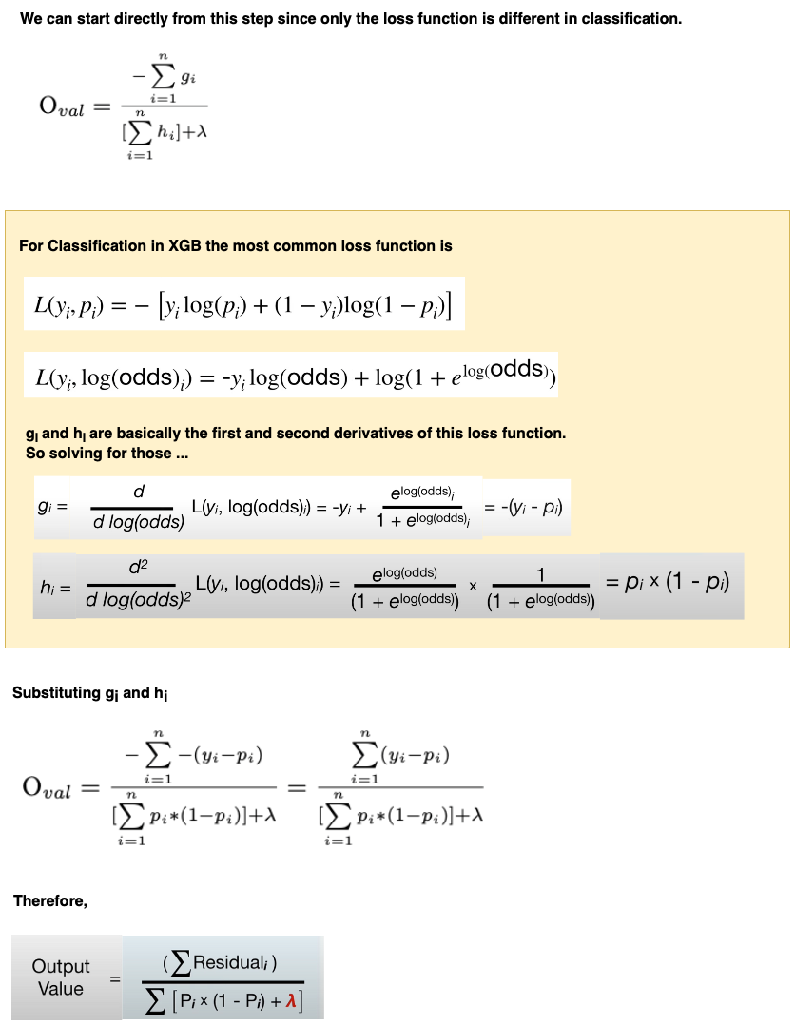
Classifier Explanation

Slide 9
Parameters used in XGBoost Algorithm
Python API Reference — xgboost 2.1.3 documentation - Classifier
Python API Reference — xgboost 2.1.3 documentation - regressor

Slide 10
Take Away
What is different from Gradient Boosting
Regularization can be done while splitting trees
Cost complexity Pruning and gamma
Approximate greedy algorithm
Weighted Quantile Binning
Sparsity Split for missing values

